Slide 1
Enabling QoS-Aware Task Execution on Distributed Node-RED Clusters for Fog Computing Environments
Daniel Sebastian Lienau

Slide 2
Agenda
Introduction
Fog Architecture
Node-RED
Task Distribution
QoS Scheduling Algorithm
Orchestrator
Evaluation
Future Work

Slide 3
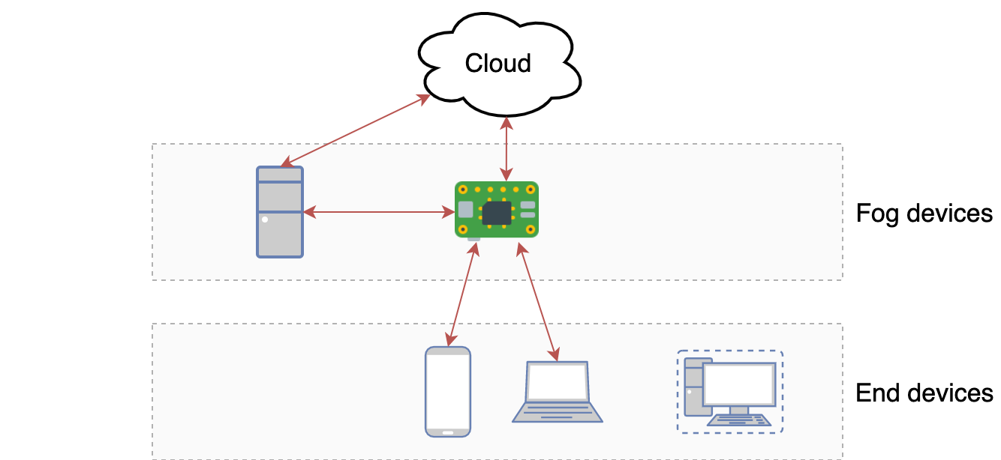
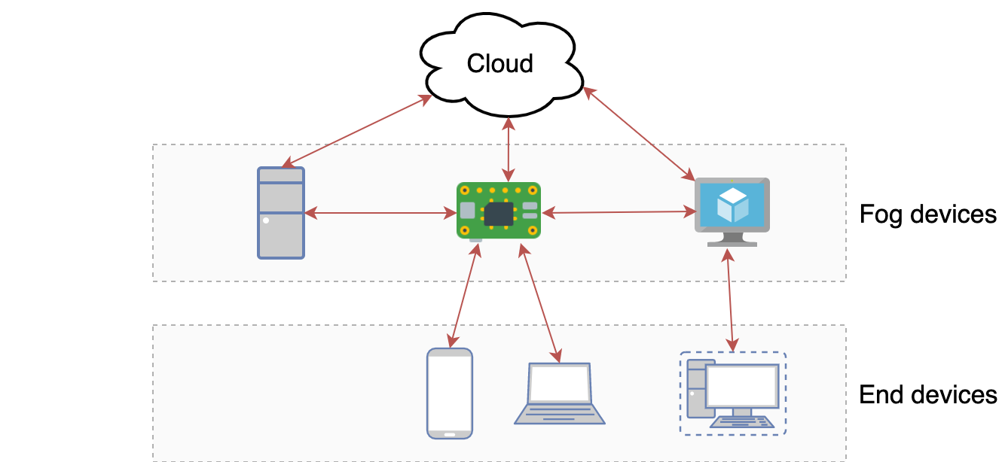
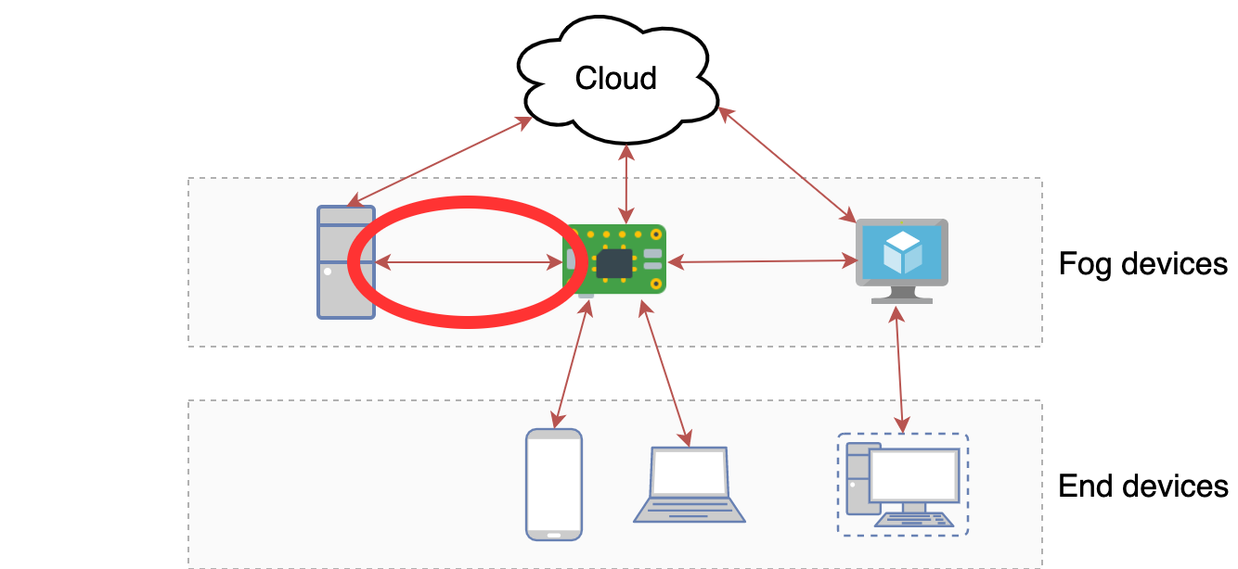
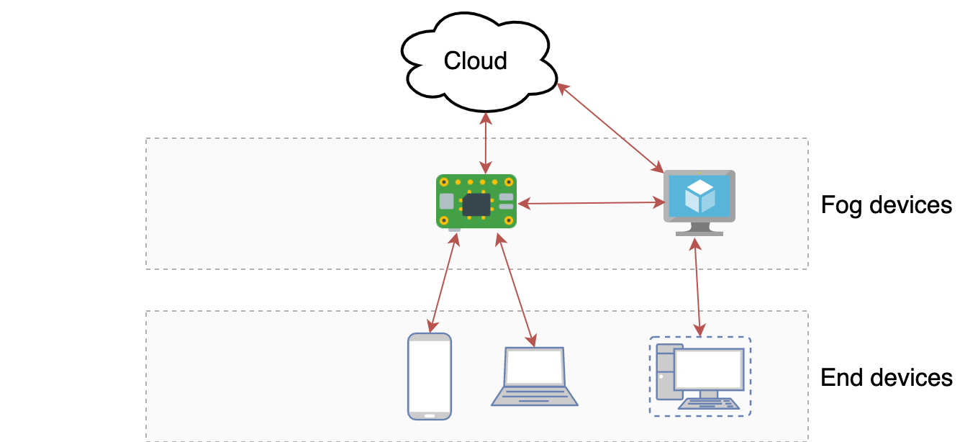

Introduction - Fog Architecture
Notes:
Vorteil: niedrige latenzen
Nachteil:
- dynamisch nodes wegfallen
- netzwerkverbindung verschlechtern

Slide 4
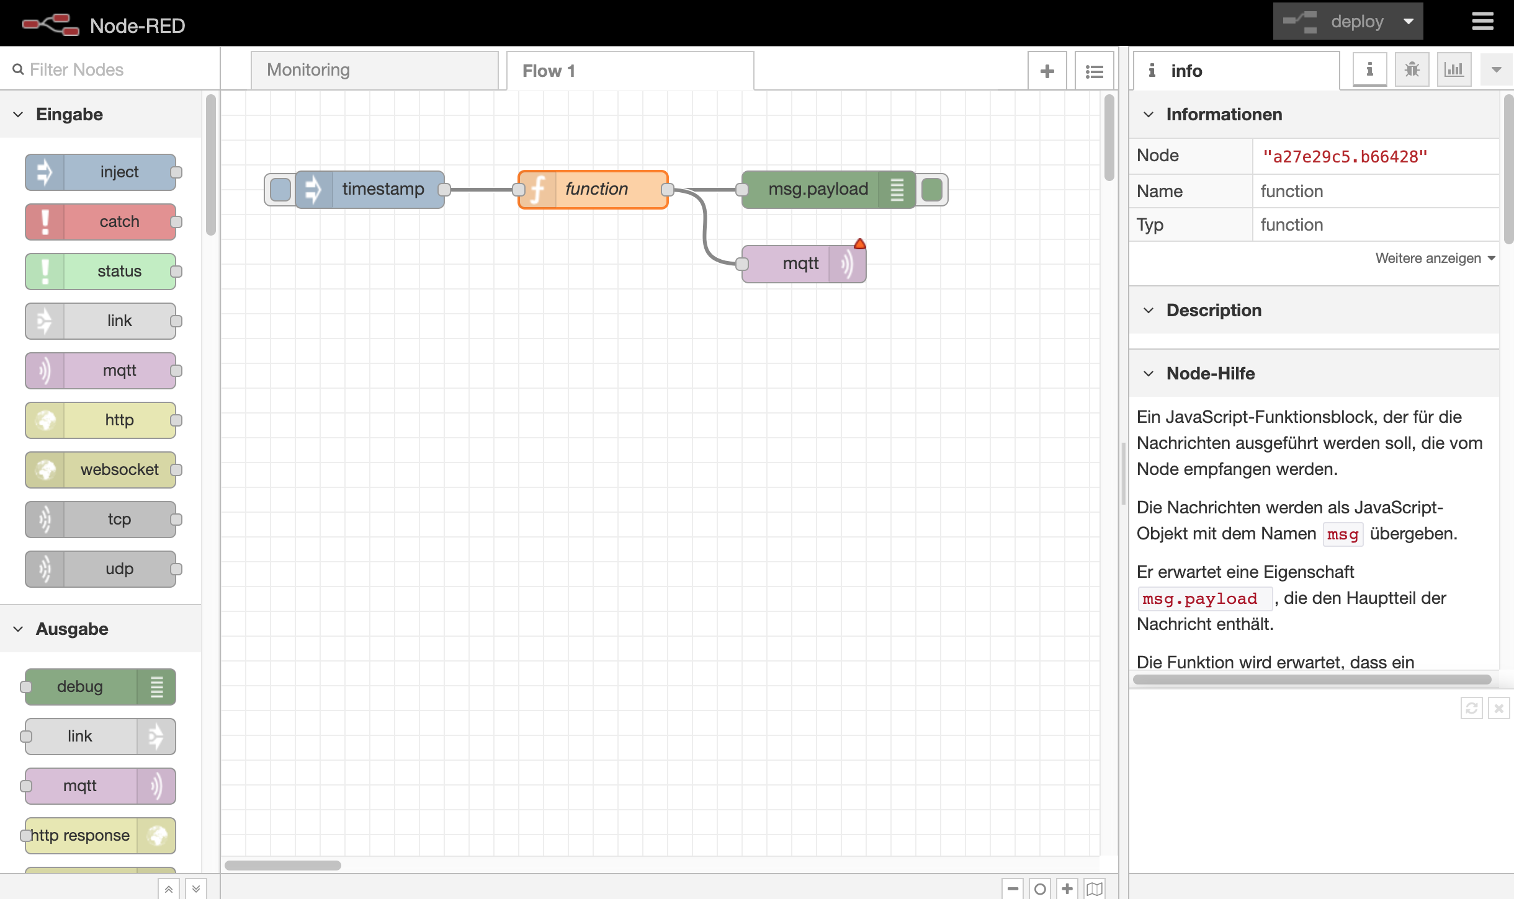
Introduction - Node-RED Flow-Editor
Notes:
Sw-Entwicklungs tool
Flow-basiertes programmieren
Nodes reinziehen und verbinden

Slide 5
Agenda
Introduction
Fog Architecture
Node-RED
Task Distribution
QoS Scheduling Algorithm
Orchestrator
Evaluation
Future Work

Slide 6
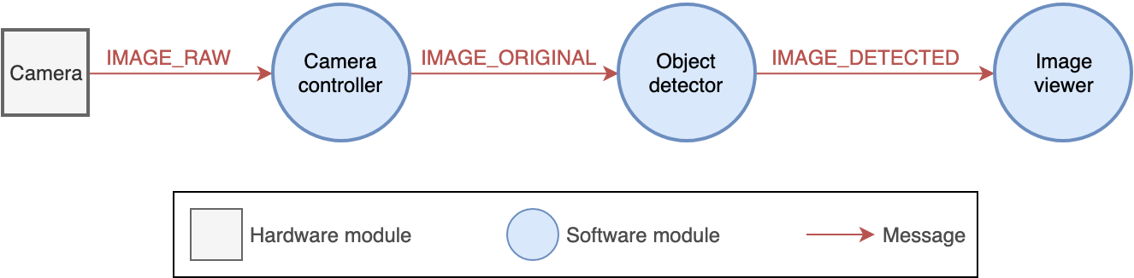
Task Distribution
Notes:
1x HW-Module
3x SW-Module
3x Message
1x AppLoop (Camera --> Image Viewer)

Slide 7
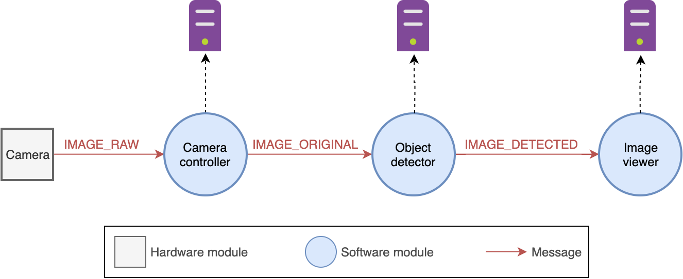
Task Distribution

Slide 8
Task Distribution - DNR
Advantages
Easy to use
Flows can be changed during runtime, DNR updates distributed flows automatically
Disadvantages
Not stable
Suitable for „small“ data, crashes if „large“ files are transferred between nodes (e.g. image)
Based on an older version of Node-RED
Not actively developed
Notes:
- erweiterung von node-red
- ermöglicht verteiltes ausführen einzelner knoten

Slide 9
Task Distribution - without DNR
Communication between Node-RED instances is managed via the HTTP nodes
Advantages
No additional Node-RED modules needed
HTTP nodes are included in the core package
Able to send „large“ data without crashes
Works with all Node-RED versions
Disadvantages
Endpoint of the receiving node must be inserted manually → Unconvenient to use
Flows must be manually exported and imported if they should be executed on another node

Slide 10
Agenda
Introduction
Fog Architecture
Node-RED
Task Distribution
QoS Scheduling Algorithm
Orchestrator
Evaluation
Future Work

Slide 11
QoS-Aware Scheduling Algorithm
Application
Modules
Messages
Loops
QoS Requirements
Algorithm
Optimal Deployment Strategy
Module → Fog node
Infrastructure
Fog nodes
Network connections

Slide 12
QoS-Aware Scheduling Algorithm - Example
 | App Module A | App Module B
RAM | 0.5 GB | 2.0 GB
Storage | 2.0 GB | 0.1 GB
MI (CPU) | 500 | 10,000
Hardware | TEMP | -
 | Fog Node 1 | Fog Node 2 | Fog Node 3
RAM | 4 GB | 1 GB | 16 GB
Storage | 10 GB | 16 GB | 100 GB
MIPS (CPU) | 1,000 | 500 | 20,000
Hardware | - | TEMP | -
Notes:
Modell von iFogSim inspiriert

Slide 13
Deployment Strategy Candidates
# | Module A | Module B
1. | Fog Node 1 | Fog Node 1
2. | Fog Node 1 | Fog Node 2
3. | Fog Node 1 | Fog Node 3
4. | Fog Node 2 | Fog Node 1
5. | Fog Node 2 | Fog Node 2
6. | Fog Node 2 | Fog Node 3
7. | Fog Node 3 | Fog Node 1
8. | Fog Node 3 | Fog Node 2
9. | Fog Node 3 | Fog Node 3
Notes:
- kombination aus allen modulen / nodes
- hardware / latency nicht beachtet
- 9 möglich

Slide 14
Hardware Requirements
# | Module A | Module B
1. | Fog Node 1 | Fog Node 1
Try to deploy Module A to Fog Node 1
 | Required by Module A | Available on Fog Node 1 | Valid?
RAM | 0.5 GB | 4.0 GB | ✅
Storage | 2.0 GB | 10.0 GB | ✅
Hardware | TEMP | --- | ❌
# | Module A | Module B
1. | Fog Node 1 | Fog Node 1
2. | Fog Node 1 | Fog Node 2
3. | Fog Node 1 | Fog Node 3
Not able to deploy Module A to Fog Node 1
Deployment candidates 1., 2. and 3. are not valid

Slide 15
Hardware Requirements
# | Module A | Module B
4. | Fog Node 2 | Fog Node 1
Try to deploy Module A to Fog Node 2
 | Required by Module A | Available on Fog Node 2 | Valid?
RAM | 0.5 GB | 1.0 GB | ✅
Storage | 2.0 GB | 16.0 GB | ✅
Hardware | TEMP | TEMP | ✅
Able to deploy Module A to Fog Node 2

Slide 16
Hardware Requirements
# | Module A | Module B
4. | Fog Node 2 | Fog Node 1
Try to deploy Module A to Fog Node 2 ✅
Try to deploy Module B to Fog Node 1
 | Required by Module B | Available on Fog Node 1 | Valid?
RAM | 2.0 GB | 4.0 GB | ✅
Storage | 0.1 GB | 10.0 GB | ✅
Hardware | - | - | ✅
Able to deploy Module B to Fog Node 1
Deployment Candidate #4 is valid ✅
✅

Slide 17
Hardware Requirements
# | Module A | Module B
5. | Fog Node 2 | Fog Node 2
Try to deploy Module A to Fog Node 2 ✅
Try to deploy Module B to Fog Node 2
❌
 | Required by Module B | Available on Fog Node 2 | Valid?
RAM | 2.0 GB | 1.0 – 0.5 = 0.5 GB | ❌
Not able to deploy Module B to Fog Node 2
Deployment candidate #5 is not valid

Slide 18
Valid Hardware Requirements
# | Module A | Module B
1. | Fog Node 1 | Fog Node 1
2. | Fog Node 1 | Fog Node 2
3. | Fog Node 1 | Fog Node 3
4. | Fog Node 2 | Fog Node 1
5. | Fog Node 2 | Fog Node 2
6. | Fog Node 2 | Fog Node 3
7. | Fog Node 3 | Fog Node 1
8. | Fog Node 3 | Fog Node 2
9. | Fog Node 3 | Fog Node 3

Slide 19
Validating Latency Requirements
Module A
Message M
(size: 2 MB)
Module B
Execution time
Transfer time
Execution time
Total Latency

Slide 20
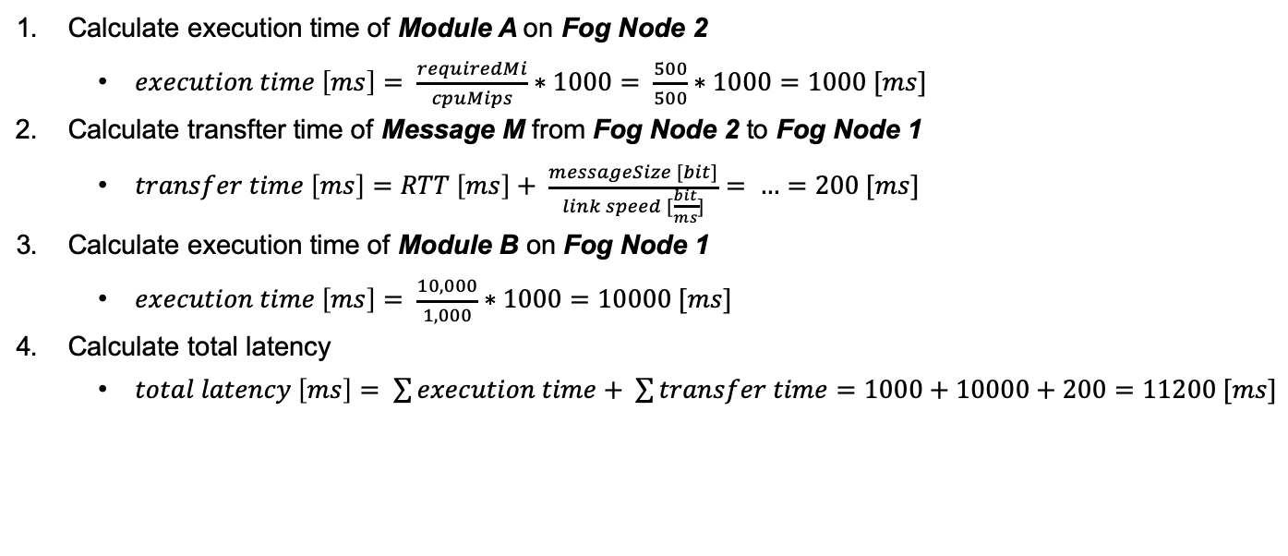
Latency Requirements
# | Module A | Module B
4. | Fog Node 2 | Fog Node 1
6. | Fog Node 2 | Fog Node 3
Calculate execution time of Module A on Fog Node 2
$execution time \left[ms\right]= \frac{requiredMi}{cpuMips}∗1000= \frac{500}{500}∗1000=1000 [ms]$
Calculate transfter time of Message M from Fog Node 2 to Fog Node 1
$transfer time \left[ms\right]=RTT \left[ms\right]+ \frac{messageSize [bit]}{link speed [\frac{bit}{ms}]}= …=200 [ms]$
Calculate execution time of Module B on Fog Node 1
$execution time \left[ms\right]= \frac{10,000}{1,000}∗1000=10000 [ms]$
Calculate total latency
$total latency \left[ms\right]= \sum{execution time}+ \sum{transfer time}=1000+10000+200=11200 [ms]$

Slide 21
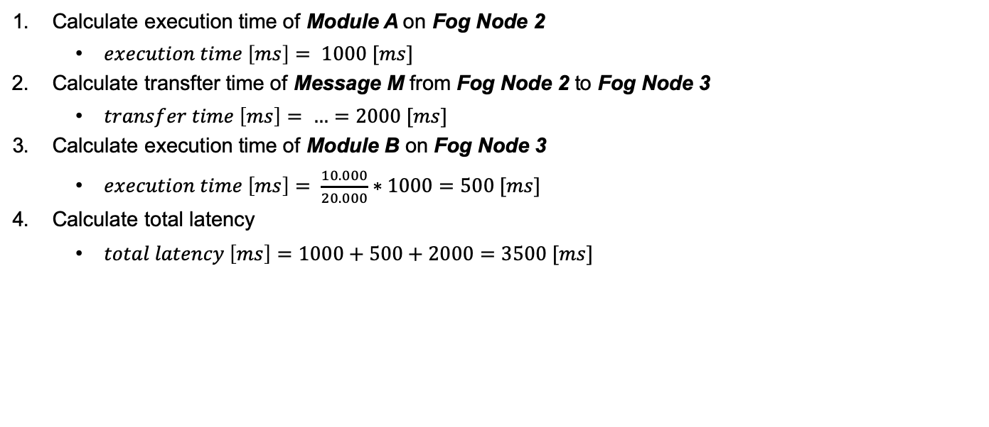
Latency Requirements
# | Module A | Module B
4. | Fog Node 2 | Fog Node 1
6. | Fog Node 2 | Fog Node 3
Calculate execution time of Module A on Fog Node 2
$execution time \left[ms\right]= 1000 [ms]$
Calculate transfter time of Message M from Fog Node 2 to Fog Node 3
$transfer time \left[ms\right]= …=2000 [ms]$
Calculate execution time of Module B on Fog Node 3
$execution time \left[ms\right]= \frac{10.000}{20.000}∗1000=500 [ms]$
Calculate total latency
$total latency \left[ms\right]=1000+500+2000=3500 [ms]$

Slide 22
Optimal Deployment Strategy
# | Module A | Module B | Total Latency
4. | Fog Node 2 | Fog Node 1 | 11,200 ms
6. | Fog Node 2 | Fog Node 3 | 3,500 ms

Slide 23
Agenda
Introduction
Fog Architecture
Node-RED
Task Distribution
QoS Scheduling Algorithm
Orchestrator
Evaluation
Future Work

Slide 24
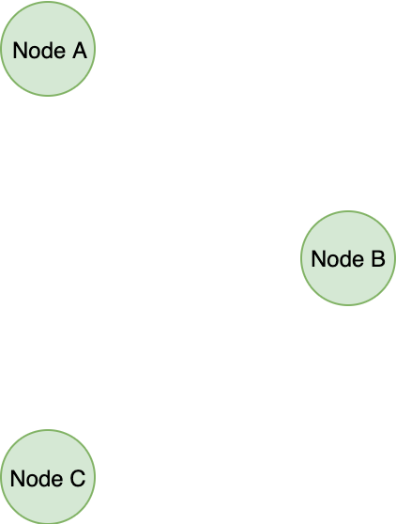
Orchestrator - Architecture

Slide 25
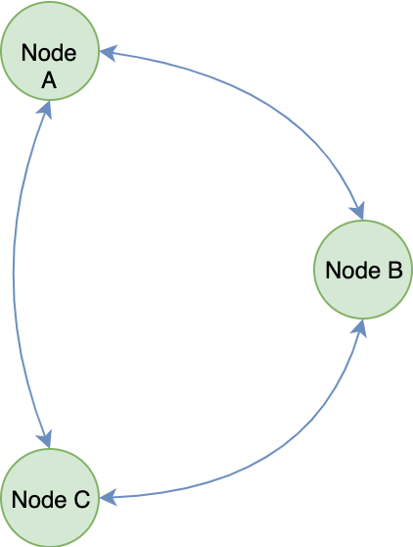
Orchestrator - Architecture

Slide 26
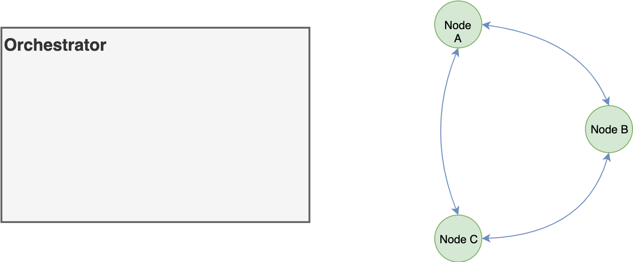
Orchestrator - Architecture

Slide 27
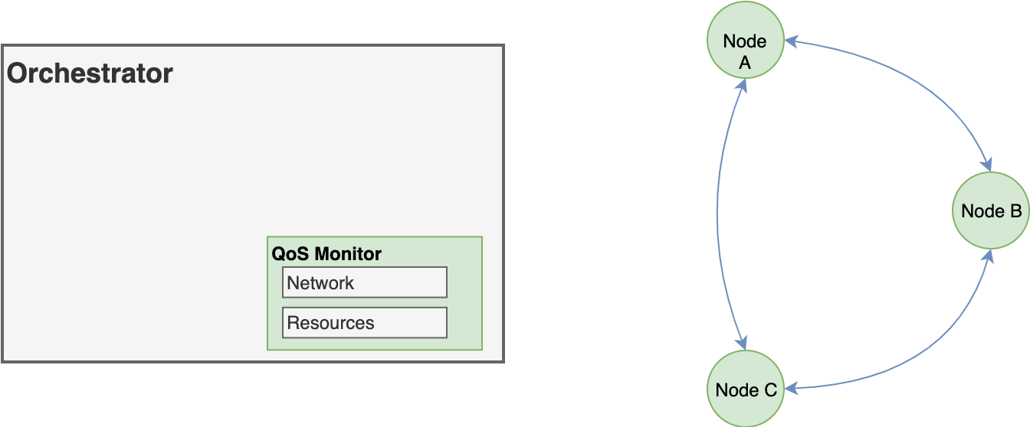
Orchestrator - Architecture

Slide 28
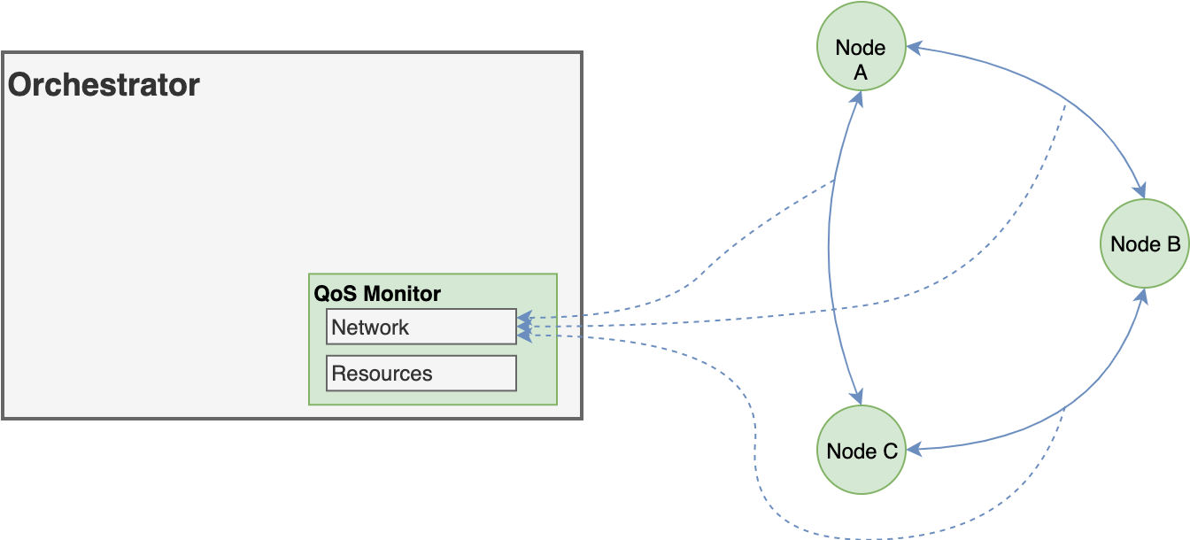
Orchestrator - Architecture

Slide 29
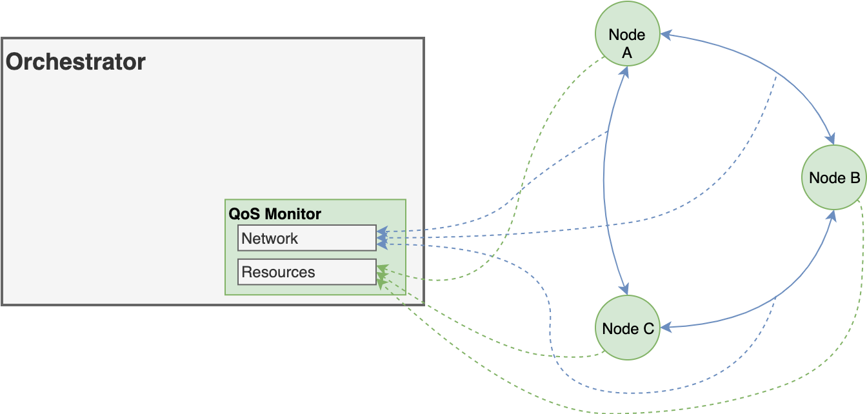
Orchestrator - Architecture

Slide 30
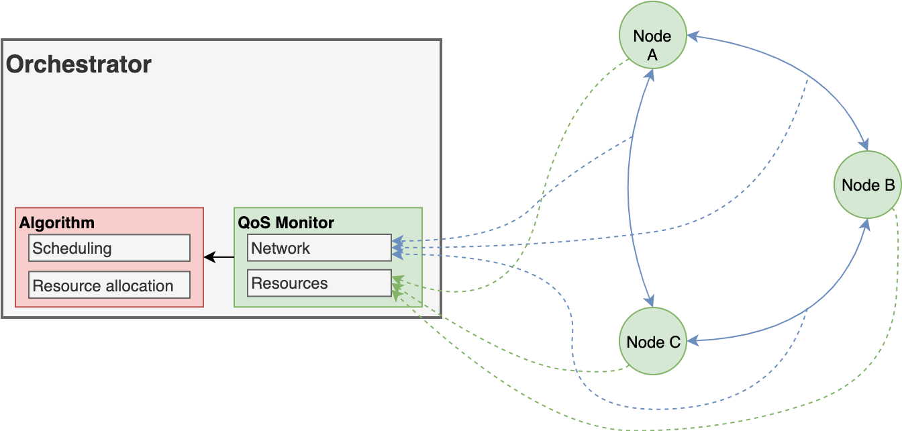
Orchestrator - Architecture

Slide 31
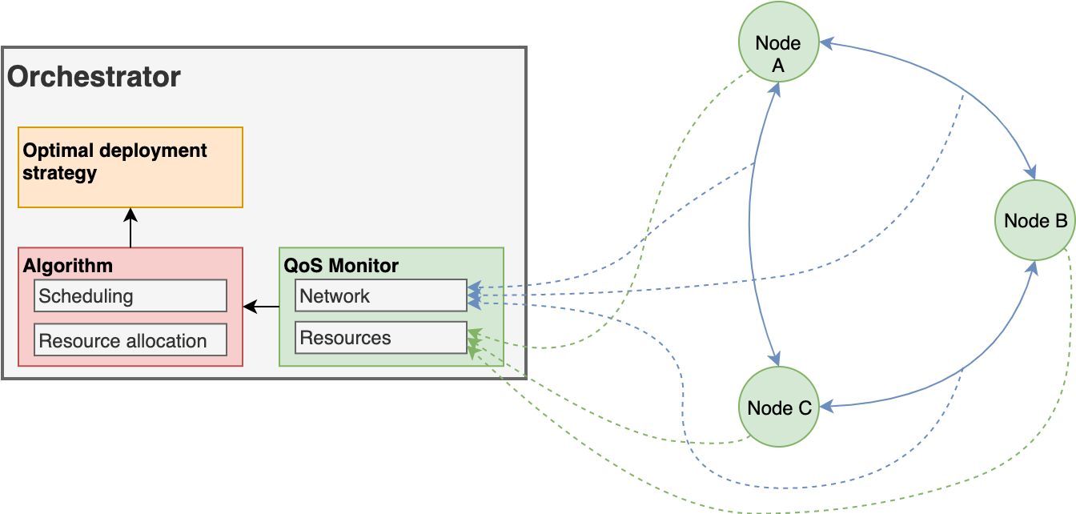
Orchestrator - Architecture

Slide 32
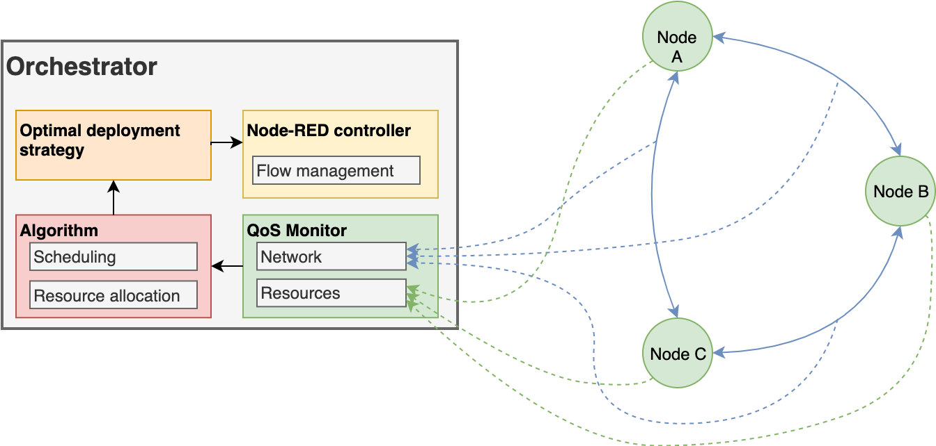
Orchestrator - Architecture

Slide 33
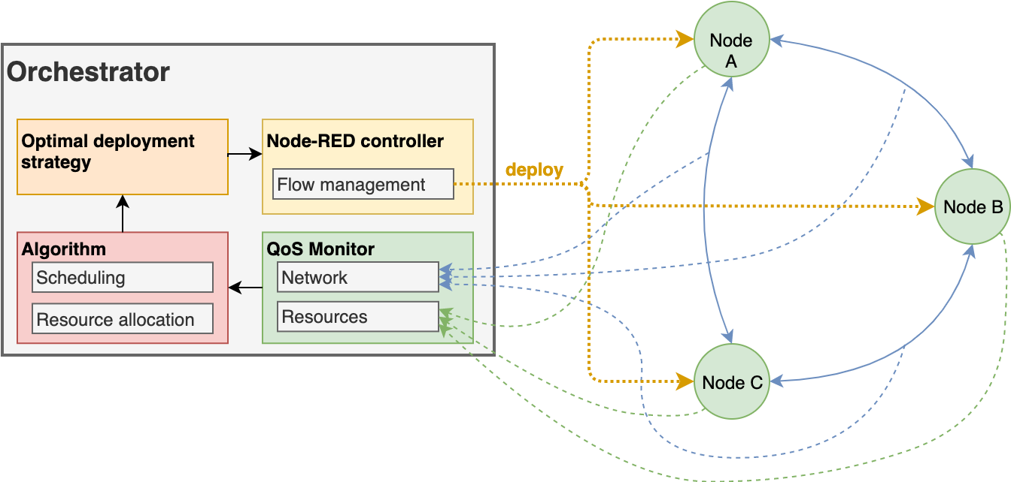
Orchestrator - Architecture
Notes:
Application ist statisch in Orchestrator

Slide 34
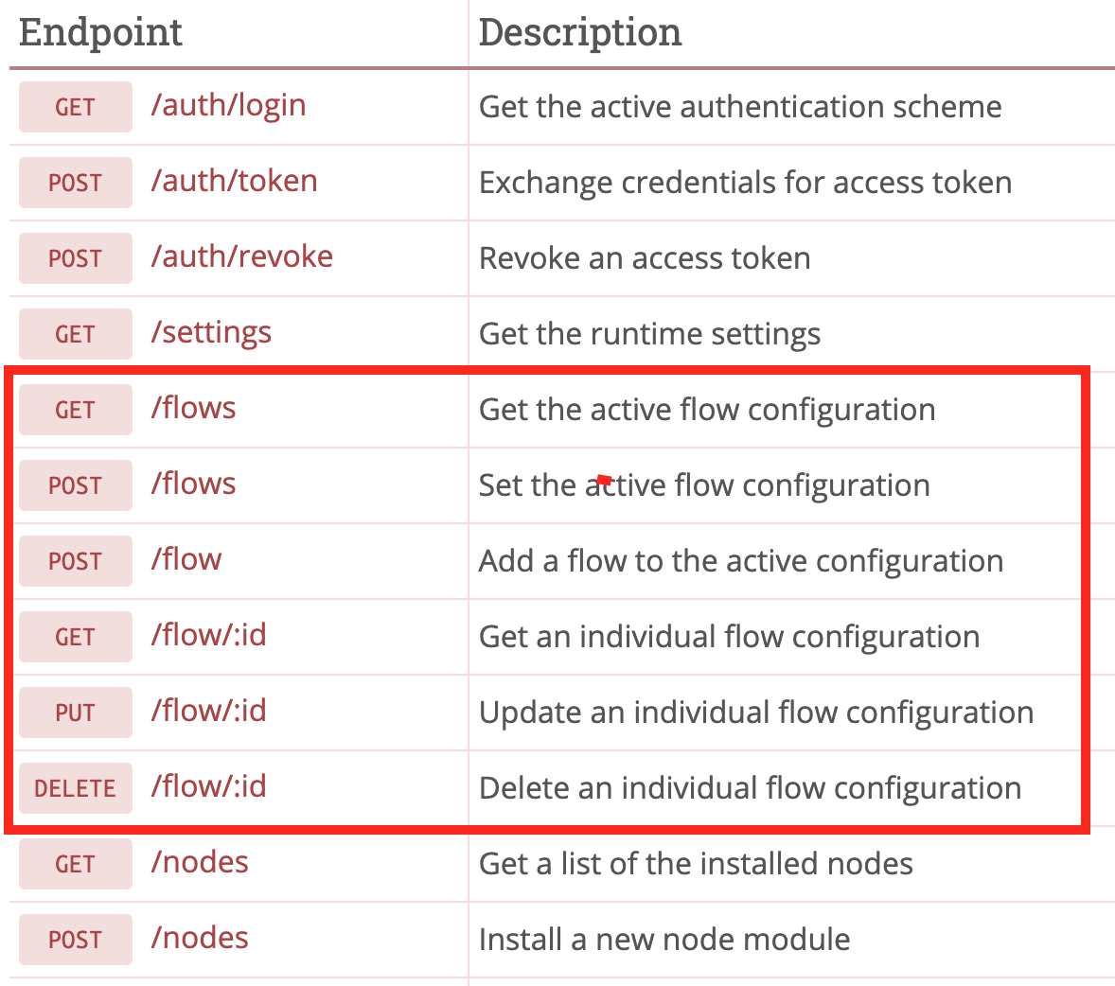
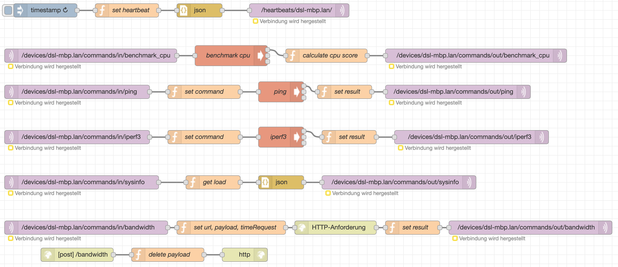
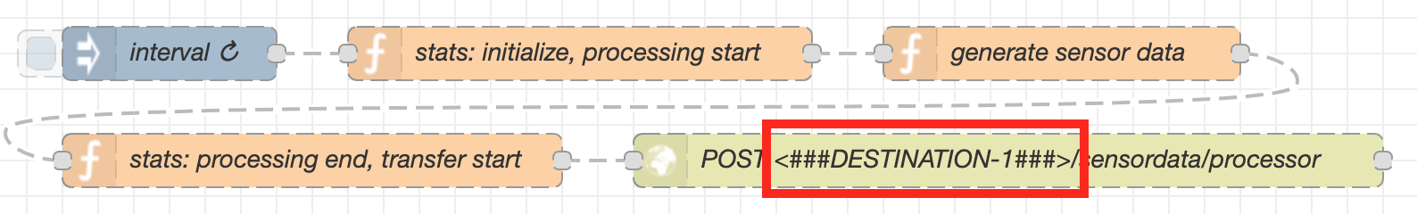
Node-RED Contoller
Uses the Node-RED Admin API
Sends commands via MQTT
Gets flows from flow database, replaces output destination, deploys flows to Node-RED instances

Slide 35
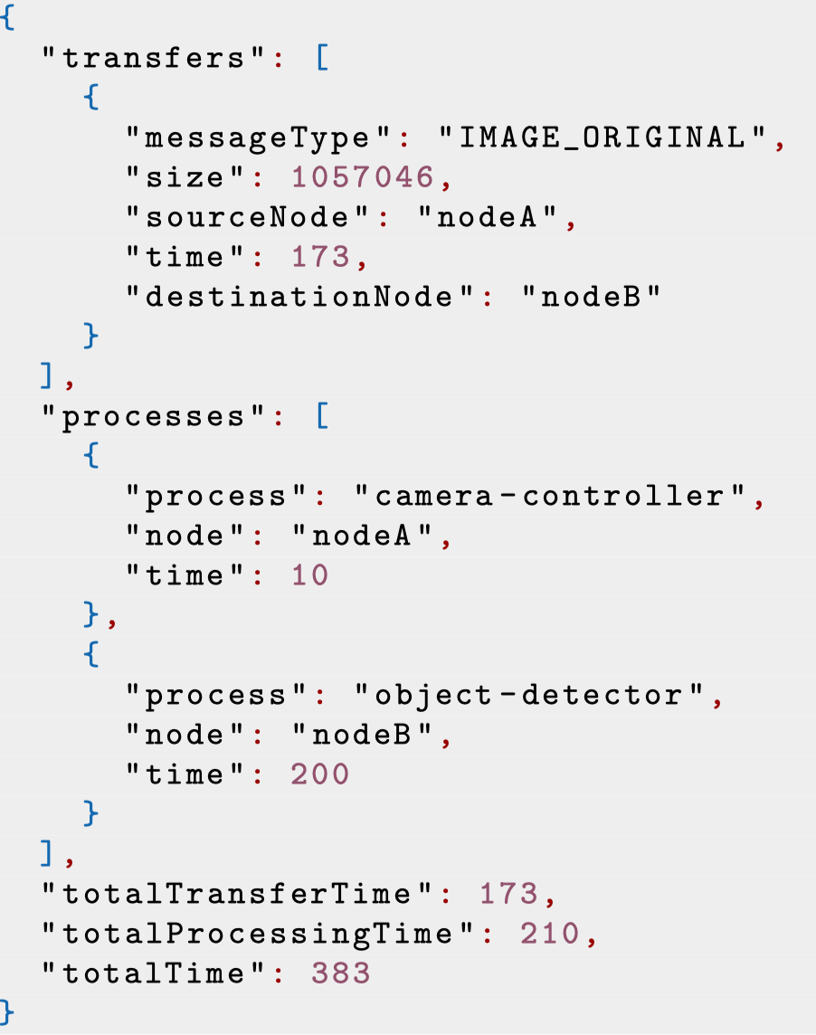
Monitoring the Current Deployment Strategy
Does the selected deployment strategy meet the QoS requirements?
A statistics object is attached to the message
Contains information about message transfers and task executions
The last module in the loop sends the object to the MQTT broker

Slide 36
Agenda
Introduction
Fog Architecture
Node-RED
Task Distribution
QoS Scheduling Algorithm
Orchestrator
Evaluation
Future Work

Slide 37
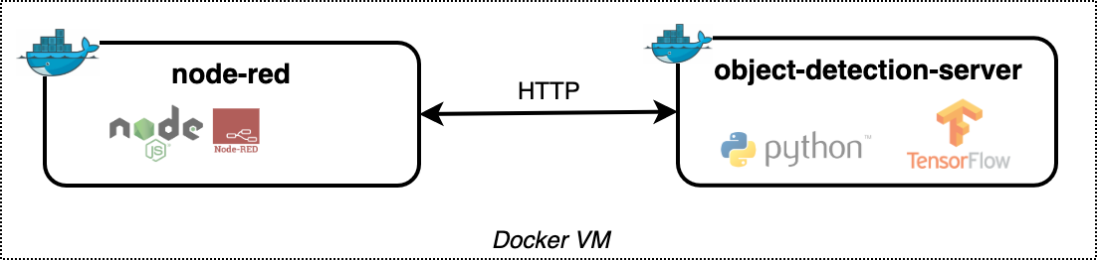
Use-Case: Object Detection Application
Steps
User uploads an image for object detection
The application returns an image containing the detected objects
Challenges
Python environment required – Node-RED natively supports JavaScript only
Initialization time: Object detection engine needs to be initialized before processing images
Solution
Separate docker container for the object detection engine
Node-RED acts as a proxy
Notes:
Node-RED kann nichts initialisieren – nur nodes nacheinander ausführen, keinen (python) state halten
Exec auf konsole

Slide 38
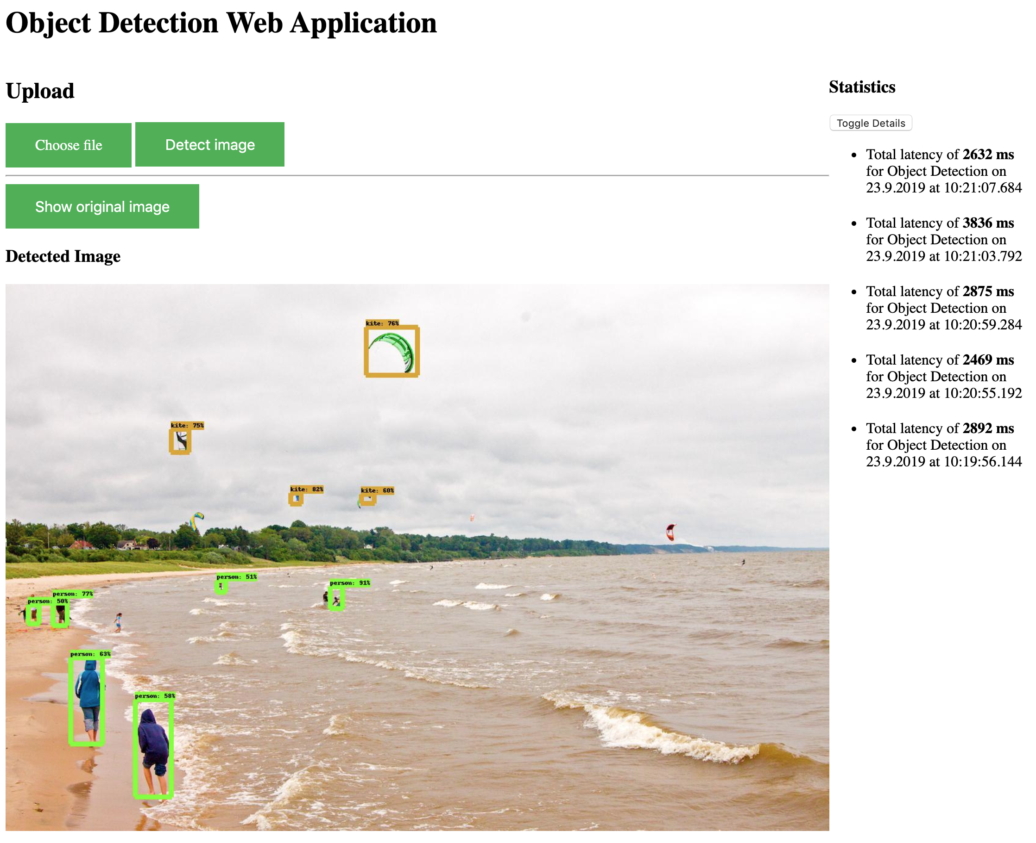

Slide 39
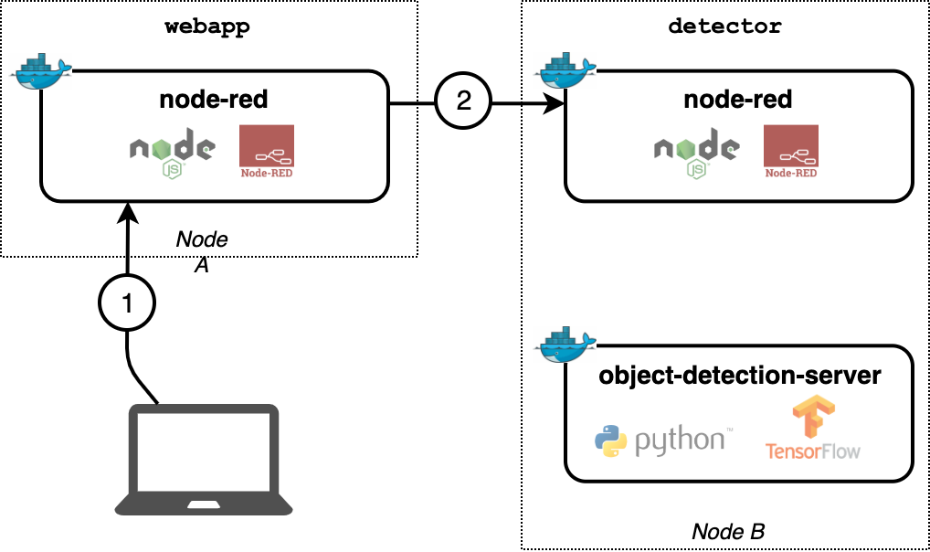
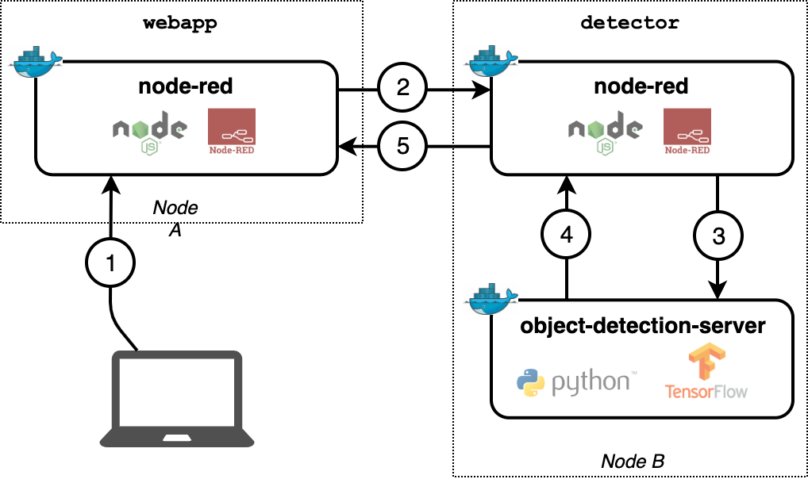
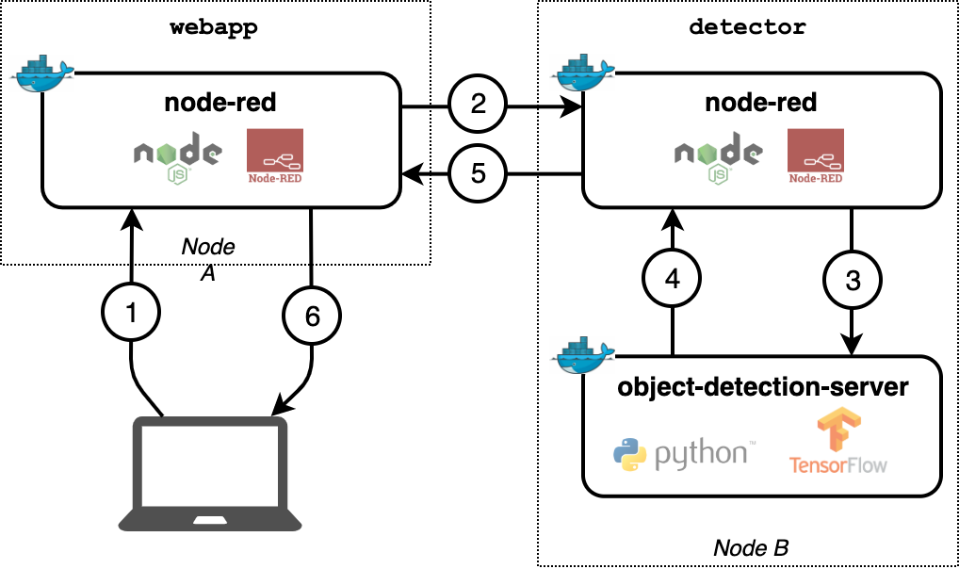
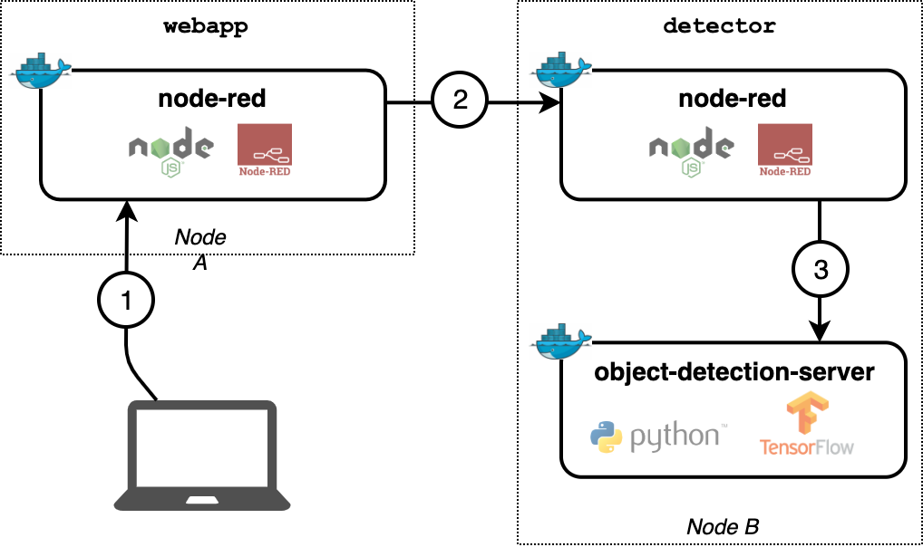
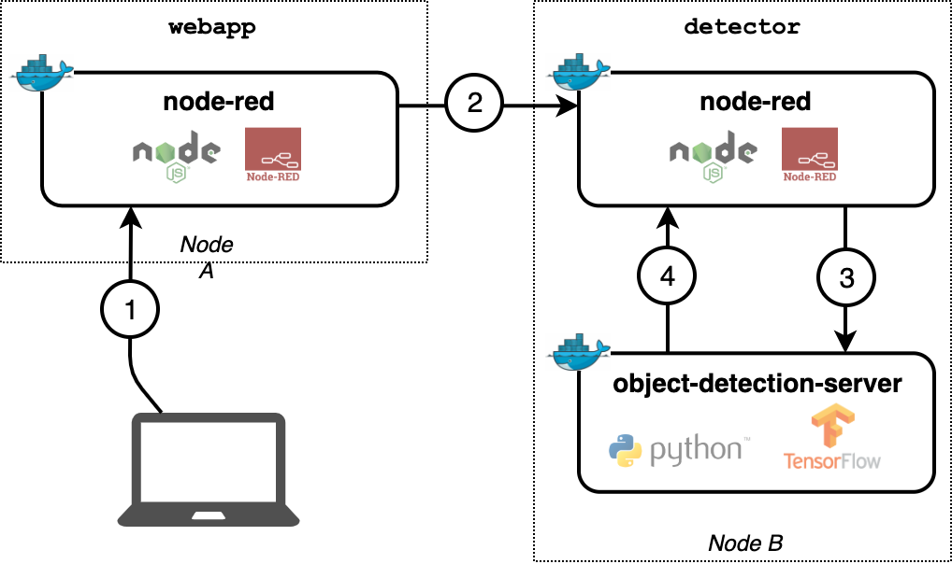
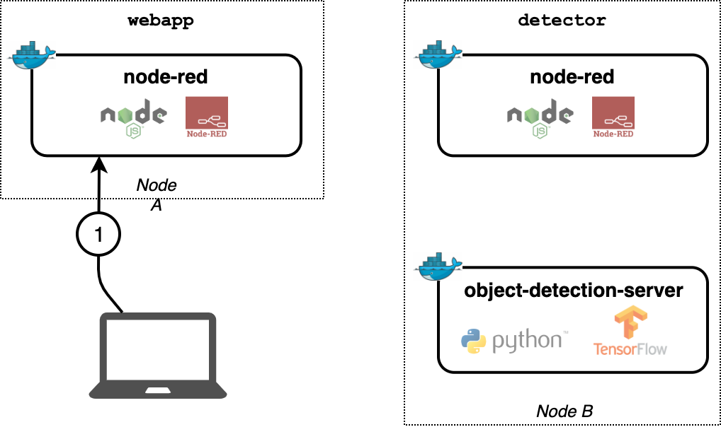
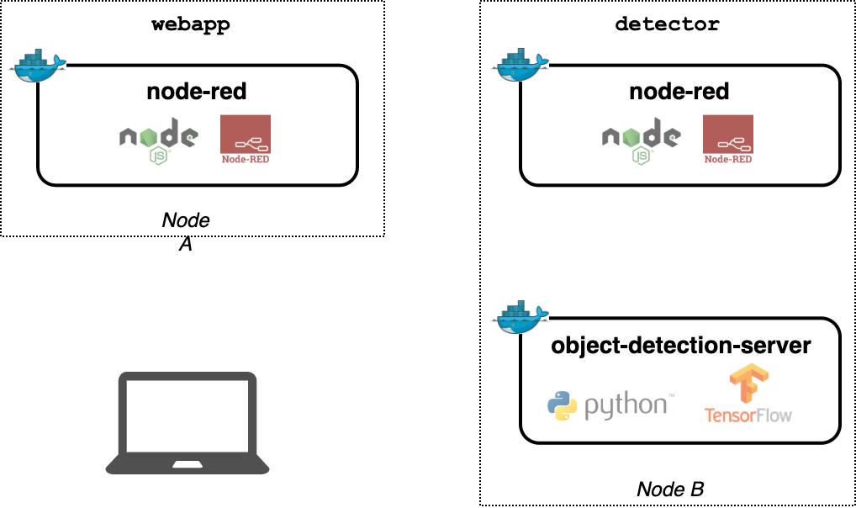
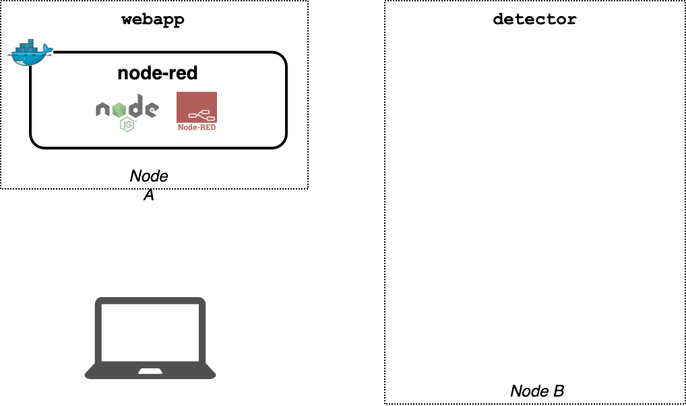
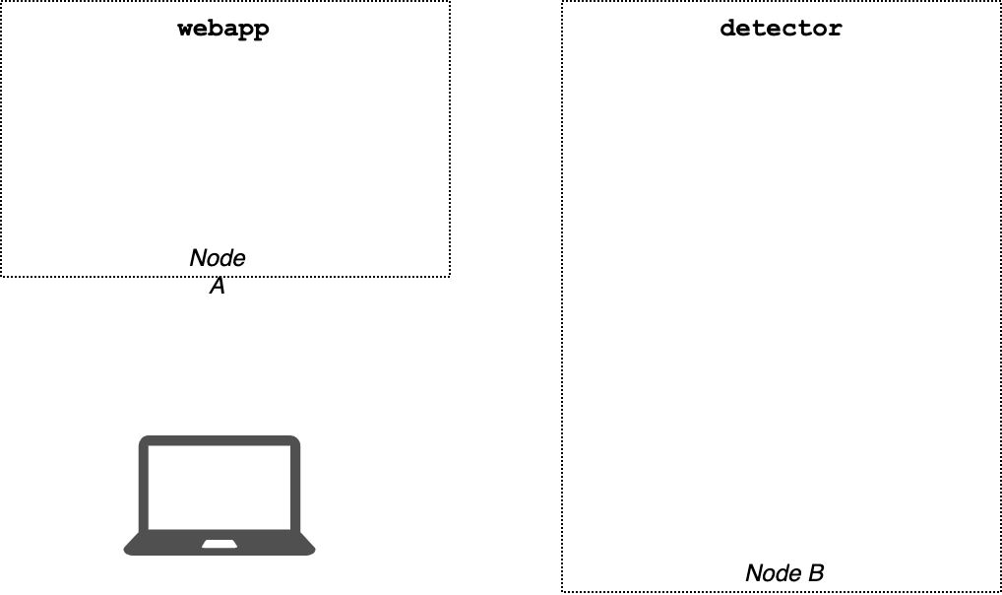
Evaluation - Object Detection Web Application

Slide 40
Evaluation - Infrastructure

Slide 41
Evaluation - Possible Deployment Strategies
Constraints
Module webapp must be deployed on raspi-01
Module detector needs the object-detection-server docker container running
Max latency: 5 seconds
Possible module placements
Module webapp can only be placed on raspi-01
Module detector can be placed on all nodes except raspi-01

Slide 42
Evaluation - Possible Deployment Strategies
Priority | Placement of webapp | Placement of detector | Latency
1 | raspi-01 | vm-02 | 1,317 ms
2 | raspi-01 | vm-azure | 2,429 ms
3 | raspi-01 | vm-01 | 2,704 ms
4 | raspi-01 | raspi-02 | 4,757 ms

Slide 43
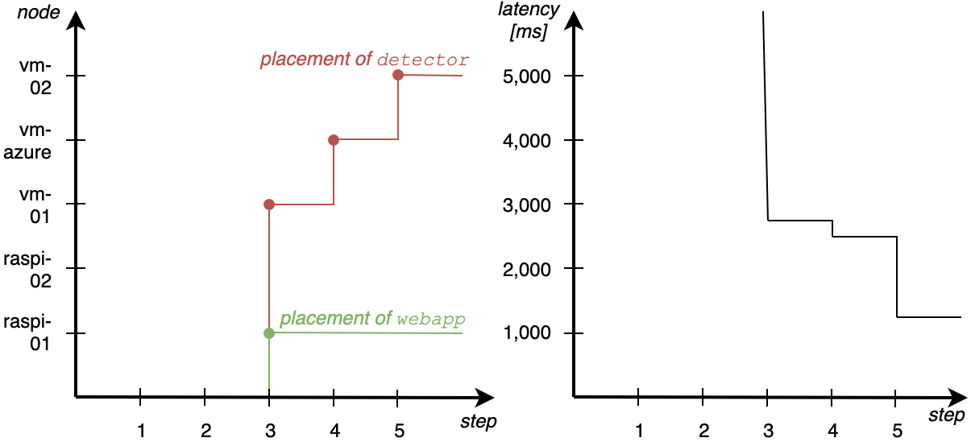
Evaluation - Experiment 1
raspi-01
raspi-02
vm-01
vm-azure
vm-02
Notes:
Nodes wurden nacheinander eingeschaltet
Netzwerk nicht belastet
Schritt zwei anders als erwartet

Slide 44
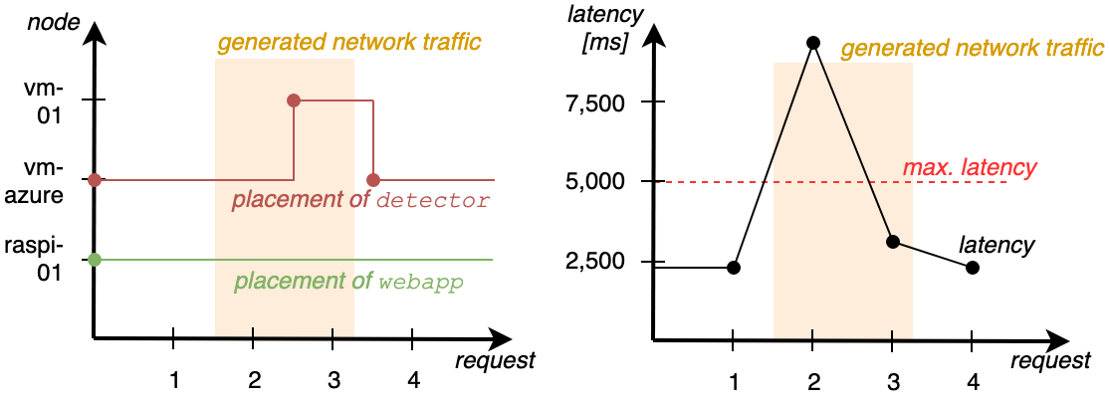
Evaluation - Experiment 2
Notes:
Drei nodes online
Zuerst netzwerk normal, dann belastet, dann normal (traffic nicht von fog nodes, sondern andere, unbekannte netzwerkteilnehmer)
Detector wurde von der cloud auf einen fog node bewegt, was die latenz minimiert hat
transferring the original image (1,382 KB) took 7,641 milliseconds instead of 1,192 milliseconds in request one
Orchestrator hat es gemerkt durch auswerten des statistics object → bandbreite aktualisiert und neues deployment berechnet
Anschließend zurück, nachdem netzwerk nicht mehr belastet war (erkannt durch regelmäßige remeasurements)

Slide 45
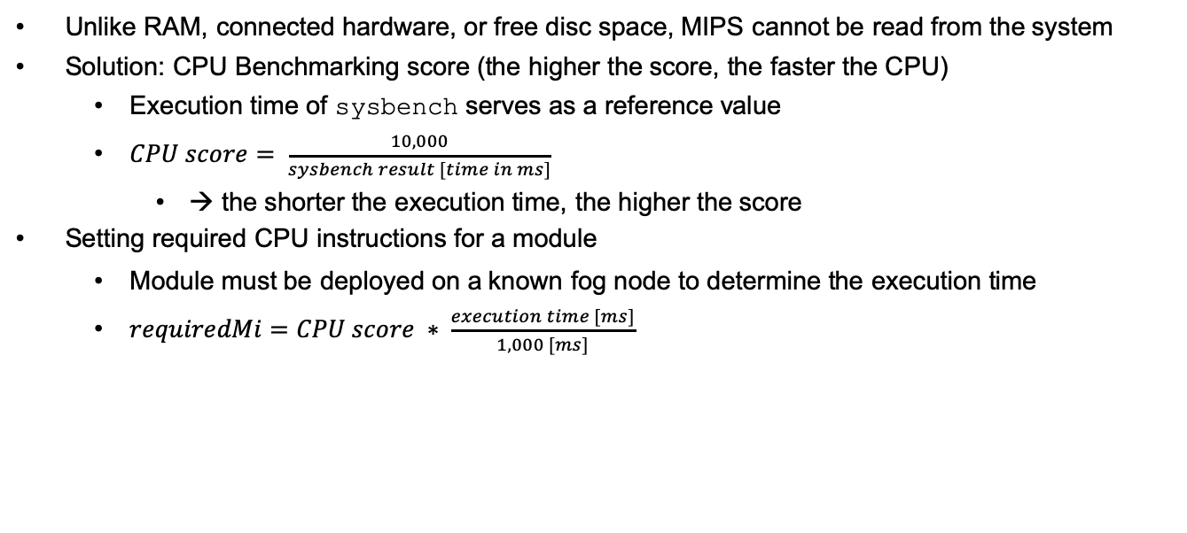
CPU Benchmarking
Unlike RAM, connected hardware, or free disc space, MIPS cannot be read from the system
Solution: CPU Benchmarking score (the higher the score, the faster the CPU)
Execution time of sysbench serves as a reference value
$CPU score= \frac{10,000}{sysbench result [time in ms]}$
→ the shorter the execution time, the higher the score
Setting required CPU instructions for a module
Module must be deployed on a known fog node to determine the execution time
$requiredMi=CPU score ∗ \frac{execution time [ms]}{1,000 [ms]}$
Notes:
- Sysbench: CLI tool das nach primzahlen zwischen 1 und einer obergrenze sucht (2.000 in unserem fall)
- CPU score benutzt für cpuMips (FogNode)
- Required instructions für Modul müssen entsprechen gesetzt werden

Slide 46
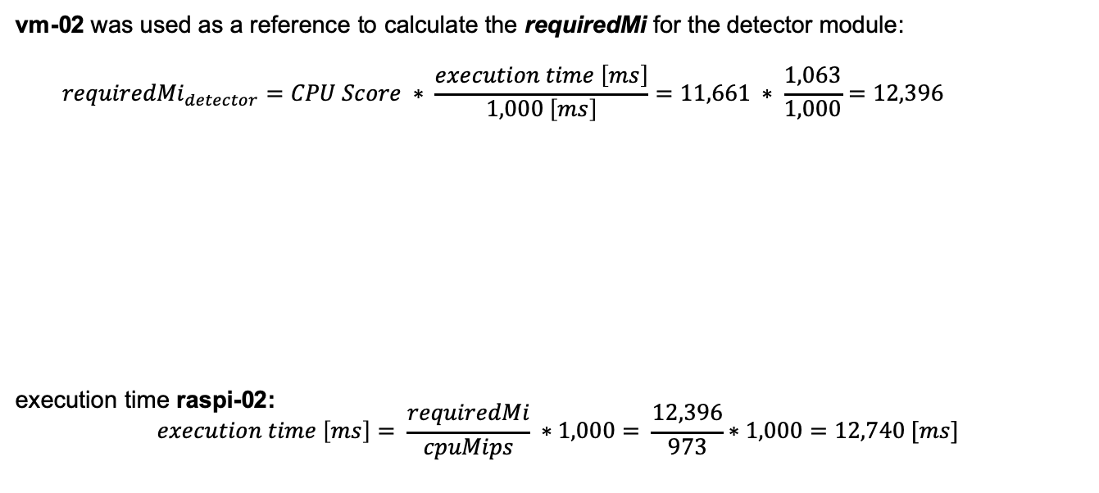
Investigation of the wrong decision
vm-02 was used as a reference to calculate the requiredMi for the detector module:
$${requiredMi}_{detector}=CPU Score ∗ \frac{execution time \left[ms\right]}{1,000 \left[ms\right]}=11,661 ∗ \frac{1,063}{1,000}=12,396$$
execution time raspi-02:
$$execution time \left[ms\right]= \frac{requiredMi}{cpuMips} ∗1,000= \frac{12,396}{973}∗1,000=12,740 [ms]$$

Slide 47
Agenda
Introduction
Fog Architecture
Node-RED
Task Distribution
QoS Scheduling Algorithm
Orchestrator
Evaluation
Future Work

Slide 48
Conclusion and Future Work
System is able to dynamically apply deployment strategies based on changing network conditions
While transfer times could be predicted fairly accurate, execution time prediction can be improved
Possible Improvements
Machine learning algorithm for predicting the execution time
Dynamic services
Orchestrator: Register new apps and modules automatically
Node-RED Subflows
Smart network measurement technique
Notes:
- Smart network measurement technique: nur in frage kommende verbindungen regelmäßig prüfen, um keinen unnötigen netzwerktraffic zu erzeugen. Oder direkt daten vom router bekommen

